Slide 1
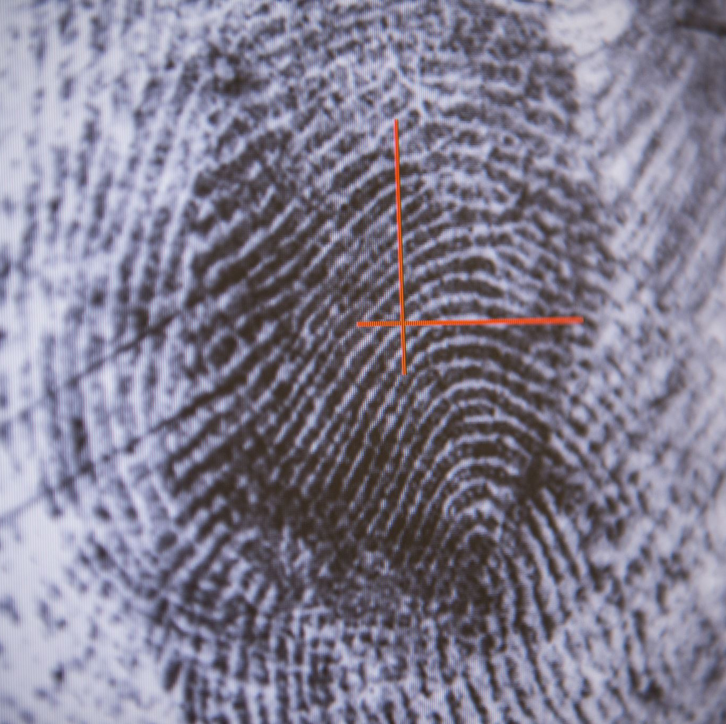
Fraud Detection
Unsupervised Machine Learning
Submitted by: John Manuel
Submitted to: Abayomi Bello

Slide 2
Project Objectives
Detect fraudulent transactions in transaction data
Compare the performance of different machine learning models
Identify the best model for real-world deployment

Slide 3
Dataset Overview
Source: https://www.kaggle.com/datasets/rupakroy/online-payments-fraud-detection-dataset/data
Features that are relevant to ML | What it Measure
amount | Transaction amount
oldbalanceOrg | Sender’s balance before transaction
newbalanceOrig | Sender’s balance after transaction
oldbalanceDest | Receiver’s balance before transaction
newbalanceDest | Receiver’s balance after transaction
isFraud | Target: 1 for fraud, 0 otherwise
balanceDiffOrig | How much was deducted from sender
balanceDiffDest | How much was added to receiver
Target metric: 1 = Fraud, 0 = Not Fraud
Categories like ‘nameOrig’ and ‘nameDest’ are dropped as these are IDs

Slide 4
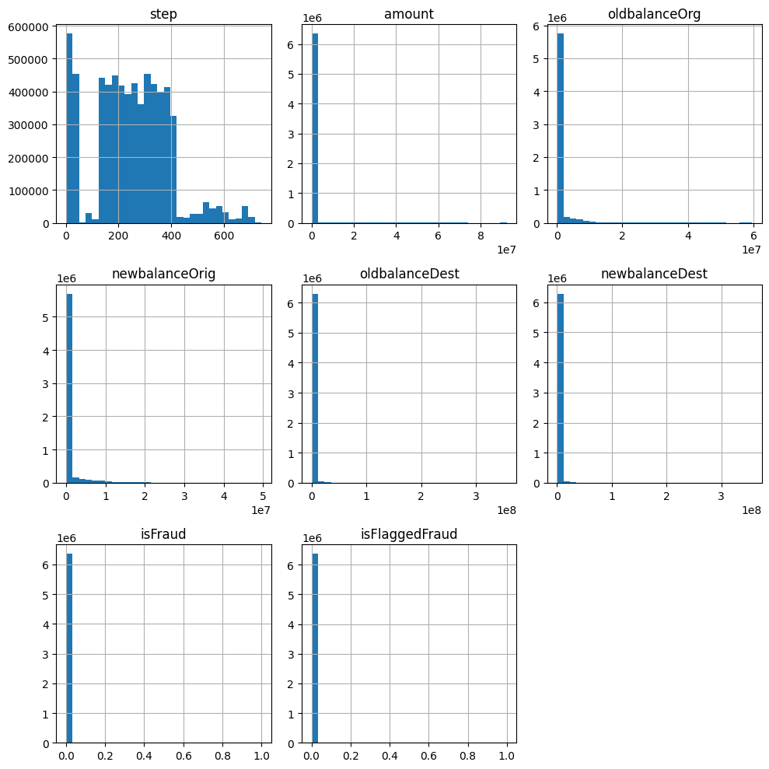
Visual Data Check
The step is slightly uniformly distributed with regular spikes in activity.
Most transactions are for small amounts, with a few massive amounts (could be fraud).
Most customers have low balances both before and after transactions, with a few bigger amounts (could be fraud).
Most of the transactions are ‘0’, meaning they aren’t fraudulent, which means there is an extreme class imbalance.
Same with ‘isFlaggedFraud’, meaning the fraud detection system in place doesn’t detect many fraudulent transactions and needs improving..
Notes:
isFraud ---- 0 = 6354407 → Non-Fraudulent
1 = 8213 → Fraudulent

Slide 5
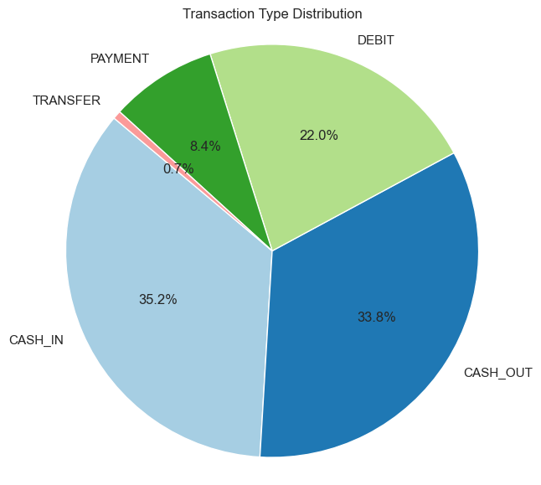
Transaction Type Distribution
Notes:
Interpretations
CASH_IN → Most common — money being deposited into an account
CASH_OUT → Almost as common — money being withdrawn or sent
DEBIT → Direct account-to-account debit#
PAYMENT → Likely bill payments or transfers to merchants
TRANSFER → Least common — regular transfers

Slide 6
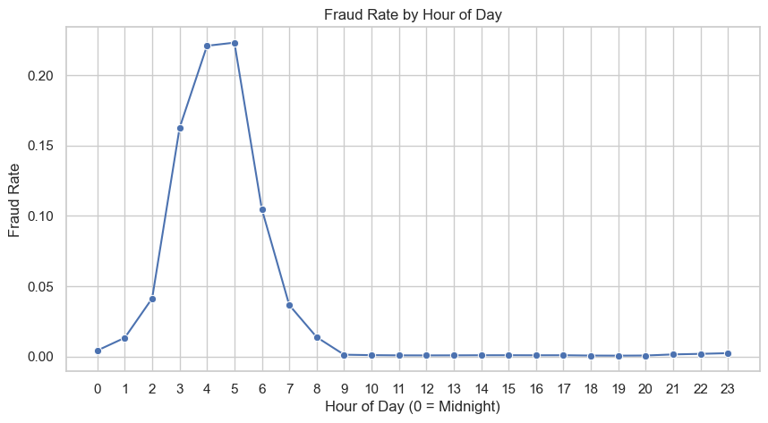
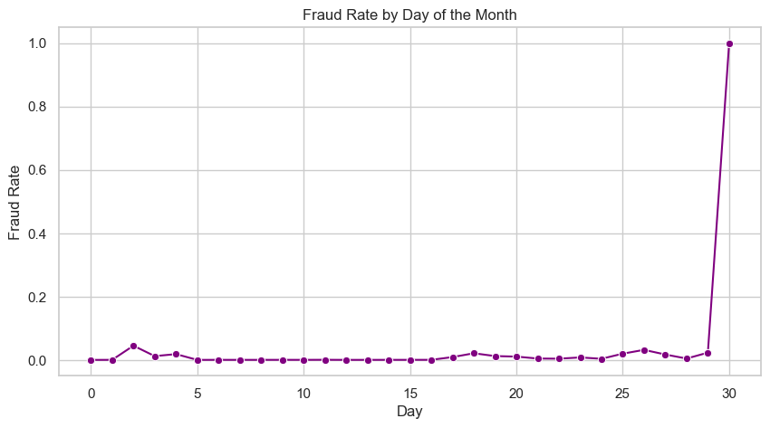
Fraud Rates (Spotting trends on fraud)
The graph ‘Fraud Rate by Hour of Day’ tells us that there is an increase of fraudulent activity from 1 am and peaks at around 5 am (26%) before coming down again, flatlining at 9 am or just before business hours.
The graph ‘Fraud Rate by Day of the Month’ shows us that there is an increase in fraudulent activity in the 2nd, 8th and peaks are around the 31st of the month. This might mean that, with most companies processing salary payments at this time, fraudsters know this is a good opportunity to conceal their activity in the noise.

Slide 7
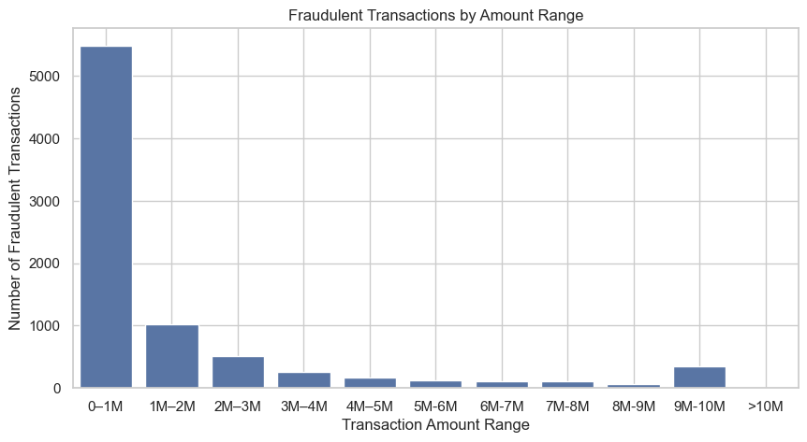
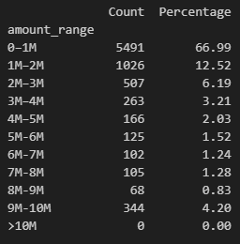
Fraudulent Transactions by Amount

Slide 8
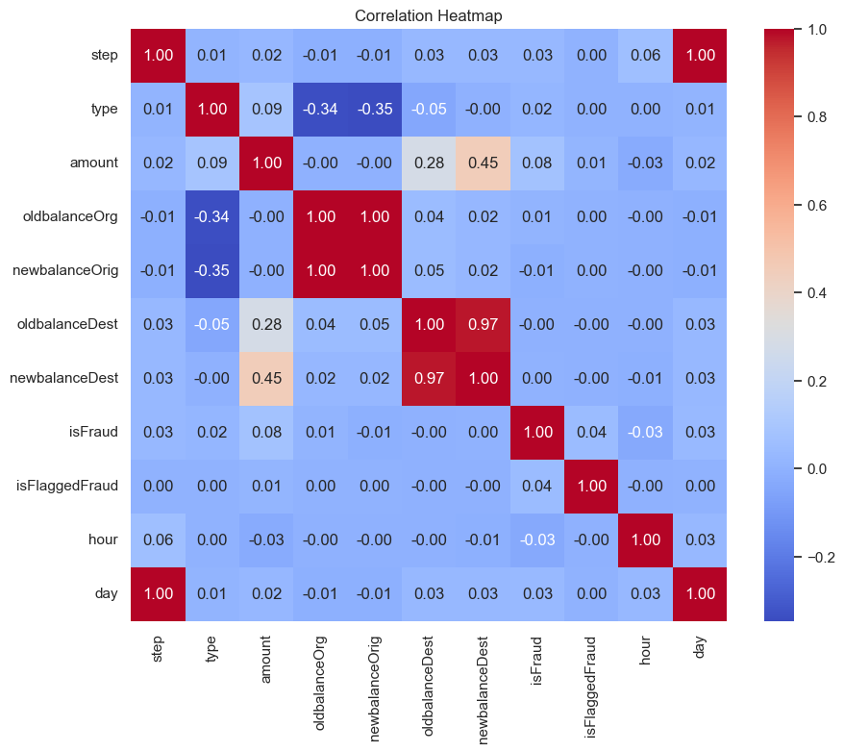

Slide 9
Data Preprocessing Methods
Checked the dataset for missing values; the dataset is clean and has no missing values.
Label encoding for categorical features, i.e. Transaction Types.
Dropped categories like ‘nameOrig’ and ‘nameDest’ as these are IDs.
Handled zero value and replaced it with the median. ‘SimpleImputer’ is used to store this value.
Perform EDA to determine class imbalance, trends etc.
Scaled the features using ‘RobustScaler’ to handle outliers.
Tested the data using both ‘class_weight = balanced’ and downsampling to 10x fraud
Feature Engineering done like Balance Differences, Transactions with Zero Transfer.

Slide 10
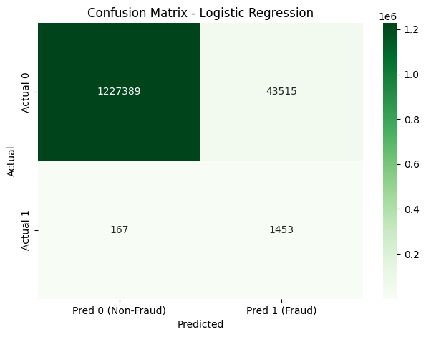

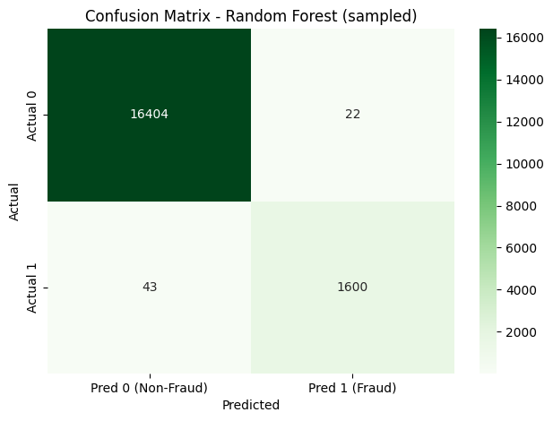
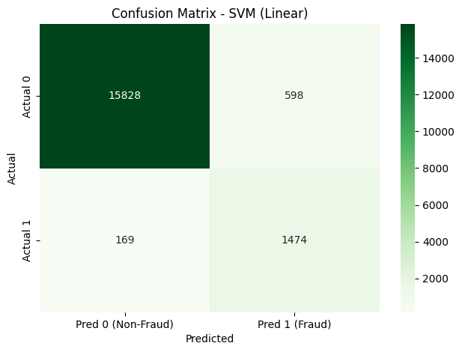
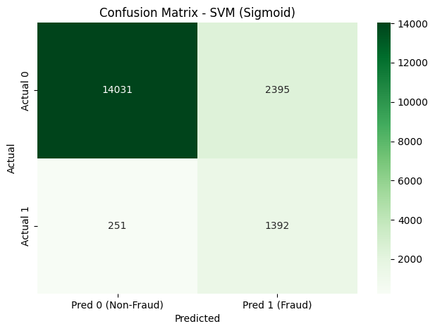

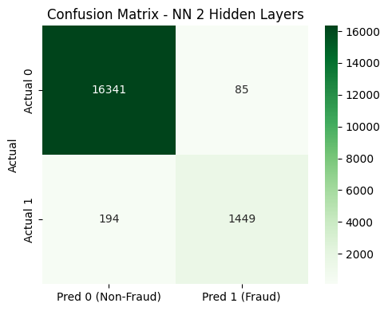
Results : Comparison of all models

Slide 11
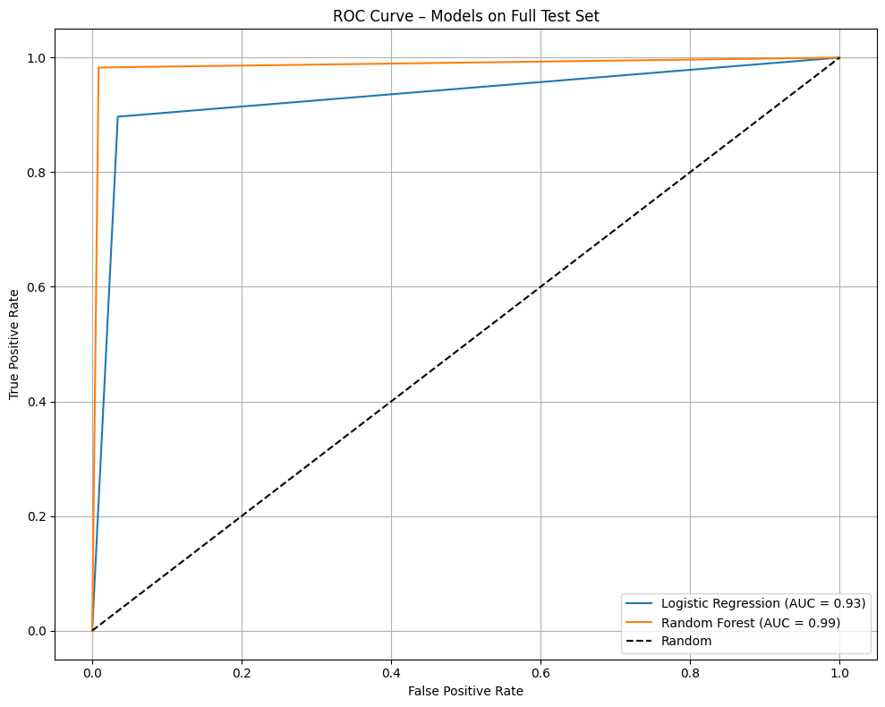
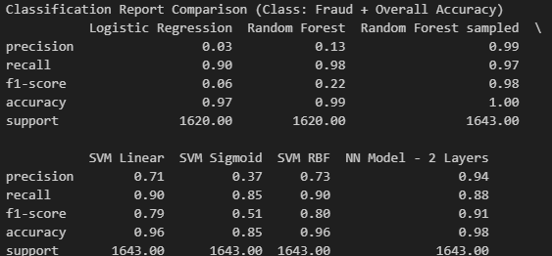
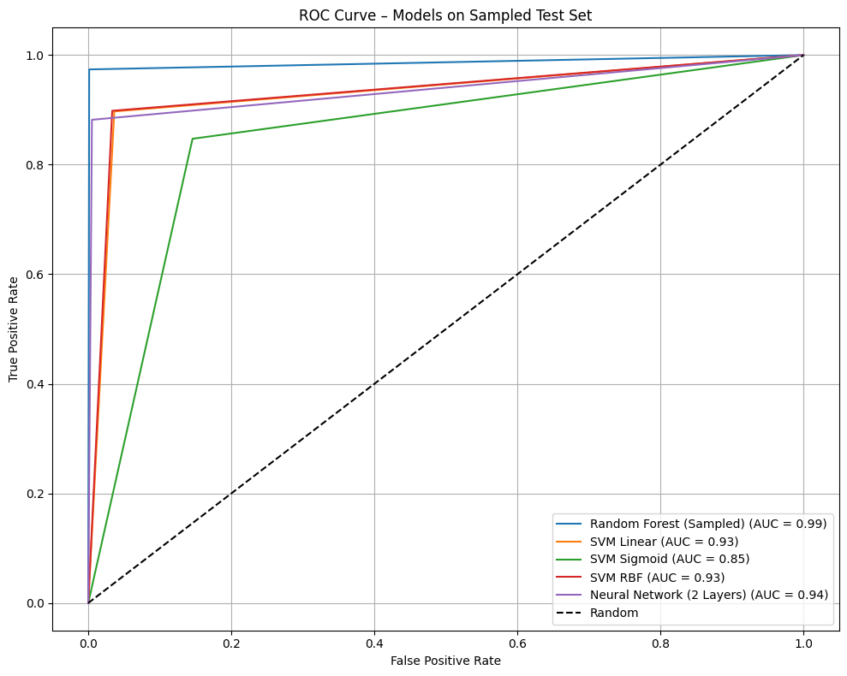
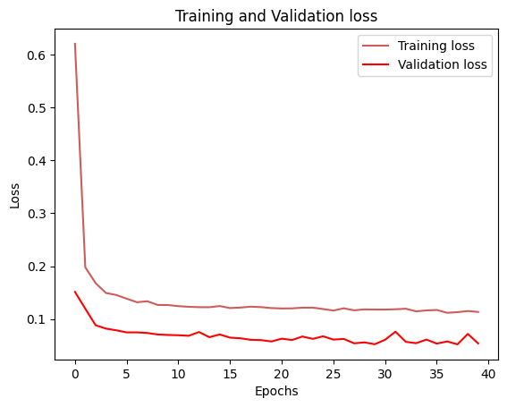
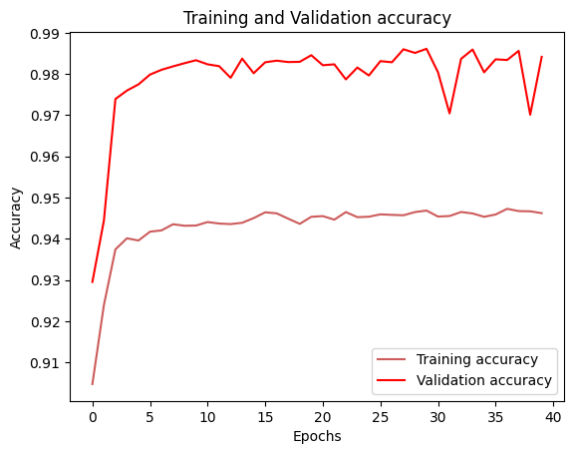

Slide 12
Results and Conclusions
Logistic Regression (38.7s training time) catches 90% of frauds (high recall) but has only 3% precision, meaning it flags almost all transactions as fraud! (false positives). This model has the worst performance thus not suitable for production.
Random Forest (6m 45s) achieves 98% recall w/ 13% precision, and with an accuracy of 99% this makes it a good model for prediction. The model only missed 28 frauds but still flags many transactions as fraud when they’re not and the dataset is severely imbalanced that the training takes a long time, undersampling was done to further improve the model.
Random forest (undersampled) (8.7s) after undersampling, achieved 99 precision and 97% recall, with 100% accuracy! An excellent balance. This model only missed 43 fraud and incorrectly predicted 22 frauds. Although lower than a full random forest, the trade-off with precision is acceptable.
The SVM models overall showed strong performance, especially the Linear and RBF kernels, which achieved a solid balance between precision (71–73%) and recall (90%), making them reliable for fraud detection; however, the Sigmoid kernel underperformed, highlighting the importance of choosing the right kernel for this task.
NN – 2 layered model delivers 94% precision, 88% recall and 98% accuracy, making it balanced and effective in real-world use. It also has the highest F1 score among all models.

Slide 13
So which model will we use for fraud detection?
Final note! While accuracy provides a general sense of how many predictions are correct, it can be misleading in imbalanced datasets like fraud detection, where the majority class (non-fraud) vastly outnumbers the minority (fraud). A model could achieve 99% accuracy simply by predicting all transactions as non-fraud, but this would completely fail to identify fraudulent cases. Therefore, precision, recall, and f1-score are more informative metrics for assessing performance in real-world fraud detection applications.
Final Recommendation:
Use a Random Forest with undersampling with 2-layer Neural Network model as back-up, as they offer the best balance of high precision, recall, and F1-score for effective and reliable fraud detection.

Slide 14
Next Steps:
Fine-tune the best models by using GridSearchCV or RandomizedSearchCV to optimize hyperparameters.
Visualise feature importance and play around with it.
Test model on a separate validation set or newer transaction data to ensure robustness.
Add ‘is_off_hours’ feature (e.g., 0–6 AM) to allow model to flag time-based risk.
Use time-aware evaluation to emphasize times where fraud is prevalent.
Investigate what type of transaction happened at what time and incorporate this at the model. _e.g. ‘TRANSFER’ or ‘CASH_OUT’.
Monitor and Retrain ins scheduled intervals as fraud patterns evolve over time.

